Slide 1
DevJam 2.0
Notes:
Apigee Edge preso in terms of key differentiators. Includes core presentation of top differentiators, along with additional persona-specific slides

Slide 2
Objectives of the Workshop
In this a hands-on workshop, you will learn how to use the Apigee Edge platform to:
Build a high-performance API out of an existing backend service using Apigee API Services
Gain end-to-end visibility across your APIs from the user all the way to your backend using Apigee Analytics Services
Understand how to quickly onboard developers and monetize your APIs using Apigee Developer Services

Slide 3
Agenda
Time | Duration (min) | Topics
09:00 AM - 09:30 AM | 30 | Apigee Edge Overview
09:30 AM - 10:00 AM | 30 | Apigee Edge Demonstration
10:00 AM - 10:45 AM | 45 | Lab 1 - Designing APIs using Swagger
10:45 AM - 11:00 AM | 15 | --- Break ---
11:00 AM - 11:30 AM | 30 | Lab 2 - Introduction to API BaaS (Backend-as-a-Service)
11:30 AM - 11:45 AM | 15 | Lab 3 - Building a simple API Proxy
11:45 AM - 12:15 PM | 30 | --- Lunch Break ---
12:15 PM – 01:15 PM | 60 | Lab 4 - Creating Composite APIs
01:15 PM - 01:45 PM | 30 | Lab 5 - Protecting APIs (Traffic Management)
01:45PM - 02:45 PM | 60 | Lab 6 - Securing APIs (OAuth)
02:45 PM - 03:00 PM | 15 | --- Break ---
03:00 PM – 03:45 PM | 45 | Lab 7 - Creating custom reports & dashboards
03:45 PM – 04:30 PM | 45 | Lab 8 - Monitoring API Health
04:30 PM – 04:45 PM | 15 | Survey & Wrap Up

Slide 4






The gap
Connected Digital Experiences
Customers
Employees
Partners
Days
Pace of change
ESB / Integration
CRM, ERP, etc.
SOA
Database
Data Warehouse
Data Lake
Years
Systems of Record
Notes:
Main Point
Enterprises face a gap between systems of record that exist and connected digital experiences that customers, partners, and employees expect
Script
The state of the enterprise today is that there is a system of record, CRM, integration technologies, app servers. There’s an entire new layer of connected experiences where customers, partners and employees are doing business with an enterprise
<build>
Those systems of record work at a slow pace. Think of them as tankers or 18-wheelers. They work well, they play a key role in the enterprise, but move slowly. Change happens in months and years. With connected digital experiences, change needs to happen in weeks and days. And the pace of change is increasing.
In short, this system of engagement cannot be delivered by existing infrastructure.
That infrastructure was built for yesterday. It only scales to millions of users. Cloud and mobile technology is considered a bolt on. It’s all about centralized security infrastructure. It makes limited use of data – in fact, data is often an afterthought. It’s built for control from a traditional IT operations. And innovation is centralized for only a few people to innovate (inside the walls of the enterprise).

Slide 5
New Demands
Connected Digital Experiences
Customers
Employees
Partners
Days
Pace of change
Secure
Scale
Manage
Analyze
Connect
ESB / Integration
CRM, ERP, etc.
SOA
Database
Data Warehouse
Data Lake
Years
Systems of Record
Notes:
Main Point
To deliver a Connected Digital Experience you need a modern infrastructure that is built for digital
Script
To deliver a Connected Digital Experience you need an infrastructure that:
Can scale to billions of users.
Do cloud and mobile first.
Security at all points of engagement, not just at the app but also at the API level
It has to have end-to-end visibility into your business with data and analytics.
It’s all about empowering developers in addition to IT.
And lastly innovation has to be distributed, enabling millions of developers to build apps and experiences that extend your business.

Slide 6
Bridging the gap
Connected Digital Experiences
Customers
Employees
Partners
Days
Systems of Engagement
Pace of change
Intelligent API Platform
Secure
Speed
Scale
Scale
Agility
Manage
Analyze
Connect
ESB / Integration
CRM, ERP, etc.
SOA
Database
Data Warehouse
Data Lake
Years
Systems of Record
Notes:
Main Point
You need a system of engagement to bridge the gap between connected digital experiences and systems of record
Script
This impedance mismatch between the system of record and the connected experience is actually quite significant and the only way to solve it is by creating a system of engagement to enable the speed and agility of the connected experience as well as maintaining the stability and reliability of the system of record.
This is where an Intelligent API Platform fits. It is the infrastructure layer to enable the digital connected experience.
The API platform provides you the speed, agility and scale you need to be successful in digital.

Slide 7






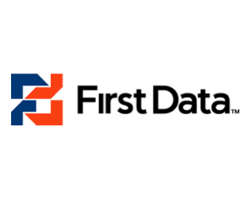












































Enabling hundreds of enterprises succeed in digital
Updated 1/26/15
Updated 1/26/15
Notes:
Main Points
Apigee has worked with hundreds of leading enterprises to help them build systems of engagement and succeed in digital
Script:
Apigee enables hundreds of leading enterprises to achieve the speed, scale, and agility they need to become a digital business.
Background Info:
Adobe: Adobe extended into digital media by building Adobe Pass which handles authentication and entitlement services for TV Everywhere broadcasters enabling customers to enjoy content on a plethora of connected devices. TV programmers working with Adobe Pass include NBC, Fox, Disney, ESPN, Cartoon Network, MTV, TNT, CNN, Scripps, Pac12, NFL Network, The Hallmark Channel, Univision, and the London Olympic Games.
Advance.net: Advance.net oversees the Internet vision and snstegy for affiliates of Advance Publications, Inc., including Condé Nast Digital, and wanted to provide partner access to the content system that drives all newspapers and magazines. Using Apigee Enterprise with internal and partner APIs they improved access to content, greater timeliness for content availability, and increased the the value of content with greater use and exposure.
AT&T: In the competitive world of Telco, AT&T recognized early the need for digital transformation of their services. Using Apigee Edge they reduced developer on-board from weeks to hours, enabled hundreds of thousands of developers to build apps on their network, increased API calls by 1500% and accelerated the pace of innovation for AT&T.
BBC Worldwide: The BBC, the worlds oldest and largest national broadcasting company, has been using APIs for the last few years. Their API traffic had grown to over 100M requests each day taxing their existing infrastructure and constraining innovation. Using Apigee Edge they transition to a platform approach with greater scalability and the ability to have standardized development practices across distributed development.
Bechtel: Bechtel is one of the world's largest engineering, construction and project management firms. They build many things from entire cities to nuclear power plants, serving the energy, transportation, communications, mining, oil and gas, and government services sectors worldwide. They are using Apigee, along with an internal API, to provide users with the right information they need, at the right time, anytime they may need it increasing efficiency and productivity.
Bitly:
Bugaboo: Bugaboo, a Dutch mobility company has a passion for innovation that results in products that inspire people to get out and explore the world. Their success required better integration to the many partners they work with. Using Apigee Edge they built a unified foundation for the web and mobile apps that streamlined partner adoption and enabled increased ability to connect directly with customers.
Burberry: Burberry, a leading luxury apparel provider for women, men, and children is part of a fast moving fashion category and needed to be innovative and become a social brand to control the social conversation. Using Apigee Enterprise with App Services they are providing the backbone for web and mobile properties increasing agility, innovation, and efficiency for Burberry.
Cars.com: Cars.com, the leading destination for online car shoppers, needed to streamline partner collaboration and reduce time-to-market by enabling real time access to core business functionality. Using Apigee Enterprise, in an existing SOA environment, they developed partner and internal APIs that standardized partner collaboration and improved efficiency while also opening them to new mobile and social opportunity.
Chegg: Chegg, the leading student hub that rents textbooks and helps students with their classes wanted to expand market opportunity by enabling partners to use its platform. Using Apigee Enterprise in an op premises deplyment they bult APIs for their affiliate program enabling partners to access their share of the 18 million college students to expand the Chegg revenue and strategic position.
Cisco NDS: The NDS Service Delivery Platform (SDP) offers connectivity between TV content, apps and online information. With it, users can deliver contextual or related online content to companion devices and smart TVs. Apigee provides the management interface for such content publication. The SDP contains APIs that allow developers to write client-side applications for devices such iOS or Android tablets or for applications on the set top box. The SDP gives developers access to information stored within the TV platform.
Citrix: Citrix provides web based facilitation tools for meetings, webinars, training, etc. Historically, Apigee was utilized to help manage traffic associated with the setup, schedule, attendance, and maintenance of such online events through a number of internet & mobile channels. With the recent release, Citrix is further extending their product suite so that core products & features could be easily incorporated into that of business partners and a consolidated offering.
Comcast:
Dell: Cloud(Hosted): Dell cloud team is implementing a new support, sales and marketing and fulfillment platform for Dell. Provide a virtual API layer the SaaS Enablement Platform [SEP]. SEP is composed of a few different applications/modules. Some of these are third party(salesforce, zuora) and some are home grown(boomi). Apigee will provide a unified RESTful API layer for this platform. Dell Open API(Onprem): .Dell open API platform enables their partners to leverage the services provided on their website dell.com through API. The API is exposed to partners only to integrate with Dell platform. Key use cases are extensive business analytics and rate limiting.
eBay: X.commerce, an eBay Inc. company, provides a technology platform, called the Fabric, which brings together a comprehensive set of commerce-related capabilities and solutions to help business of all sizes, compete and grow. They offer a complete set of flexible, customizable, and cost-effective commerce-related capabilities via APIs from standalone to end-to-end solutions so businesses need to integrate with just one platform, X.commerce. X.commerce is also the single destination for businesses seeking to connect with developers who can provide integration support. Developers or other capability providers can publish and distribute their applications to a vast pool of businesses seeking commerce-related help, or connect with businesses in need of integration expertise saving time by writing their code once, without the need to rewrite it each time that application is integrated with a new merchant or business.
Equifax:
Equinix: Equinix, Inc. is an American public corporation that provides carrier-neutral data centers and internet exchanges needed more scalable API infrastructure. They built FASE (Flexible Application Services Engine), with Apigee Edge, a next-gen simplified application development platform for rapid development of scalable & robust apps
European Patent Office: The European Patent Office (EPO) needed to improve security and performance of access to their Internal API used between offices after experiencing hacking attempts to retrieve their entire catalog. Using Apigee Enterprise, with Gateway Services, they addressed both their security and performance issues and increased their ability to grow to meet increasing use of their APIs.
Financial Times: Financial Times, a leading global business news organization, recognized the important of the transition to digital in their industry and embarked on a ‘digital first’ strategy using Apigee Edge that puts primary focus on delivering news digitally, and secondarily through print. As a result they have greater flexibility to deliver news the ways customers want it, and greater internal efficiency in doing so.
First Data: First Data was challenged by fast moving, agile competitors and as a result needed better partner integration. Using Apigee Edge they built partner APIs that enable them to compete at a faster pace eliminating the digital advantage of upstart competitors. One of their initial partners was Apple with APIs being used for Apple Pay.
GameStop: Ranked 255 on the Fortune 500 annual listing of public companies, GameStop is the world’s largest video game and entertainment software retailer. The company operates more than 6,500 retail stores worldwide, as well as GameStop.com and EBgames.com. Game Informer magazine, a leading multi-platform video game publication, is also an important part of the GameStop family. GameStop leverages Apigee Enterprise API management infrastructure to implement a multi-platform/multi-device strategy to grow its customer base and reach.
Globe: Globe, a leading telecom in the Philippines needed to transform to digital services like most of their competitors, and needed to unlock the value in legacy systems. Using Apigee Edge they transitioned to APIs increasing efficiency and establishing the digital foundation for today and tomorrow.
Gogo: Gogo was looking to expand revenue and reach through new partner channels. Using Apigee Edge they built a partner API that streamlined 3rd party app sponsorship at scale enabling greater sales of their online services. Your travel planning app, like Concur, may have this built in.
Gracenote: Gracenote is the largest provider of music and video metadata and needed a better developer experience to sell their services to their primary audience, developers. They used Apigee Edge for the enablement of their developer outreach program through significant portal customizations and created a better experience along with streamlining developer processes..
HCSC: Health Care Service Corporation operates the Blue Cross and Blue Shield programs in Illinois, New Mexico, Oklahoma, and Texas. Apigee is helping them with a strategic transformation to digital business which will increase agility, customer interaction, and enable them to adapt to a very dynamic industry.
Independence Blue Cross: Provides health insurance to the residents of southeastern Pennsylvania and needed to reduce complaints to Medicare. Using Apigee Insights to predict potential complaints there were able to reduce complaints by 50% and transform to proactive support that increased customer satisfaction.
Infogroup: Infogroup, a leading provider of analytically driven consumer and business data, needed to transition from physical media delivery to a faster, more agile method. Using Apigee Enterprise they build open and partner APIs that enabled customers faster data access, and improved revenue opportunity with the addition of customers that need data in the real-time world of social and mobile communities.
Inmarsat: Inmarsat is a leading provider of global mobile satellite communications and needed scalable API foundation to roll our their Global Xpress apps and services. Global Xpress, which will create the world’s first globally available, high-speed mobile broadband service delivered through a single network operator. Using Apigee Edge they built a scalable foundation and have now launched two to three satellites necessary to begin operation.
IntraLinks: Intralinks integrates the capabilities of content management, collaboration, and workflow solutions in a secure and compliant environment that is delivered with an on-demand, SaaS-based business model. Using Apigee they streamlined their partner integration increasing efficiency and reducing time to market.
IQT: In-Q-Tel is a not for profit investment firm supporting the US Intelligence community and needed a solution that could support information organizations at various stages of their API initiatives. They chose Apigee Edge and are working to bring greater flexibility and faster time-to-value to government information projects.
ITV: ITV, the largest TV network in the UK, needed to streamline their digital infrastructure as part of their digital transformation. previous built with point solutions. Using Apigee they are providing greater flexibility to simplify their digital transformation and enable new opportunities to drive revenue from existing content assets.
Kaiser Permanente: Kaiser Permanente, a leading healthcare organization that offers nonprofit healthcare plans recognized the need for transformation to adapt to the changing healthcare market. They are using Apigee to power this digital transformation with expanded service to mobile devices and integration of customer fitness devices to increase the value of the customer relationship and enable the agility needed to take advantage of emerging business opportunities.
Landsbankinn: Landsbankinn in a leading Icelandic financial institution that was not able to easily adapt to innovation and channel acceleration initiatives. Using Apigee Edge, they built APIs to simplify access to their systems and are delivering the infrastructure for increased partner business opportunity.
Laterooms.com: Laterooms.com. A digital native hotel room booking business, was challenged by hotel integration and needed to upgrade to a more scalable solution that would enable future growth. Using Apigee Edge, they were able to accelerate their development of APIs and reduce the time to integrate a new hotel partner.
LiveNation: the world’s leading live entertainment and eCommerce company needed to expand the event experience with pre and post event activities. Using Apigee Enterprise platform in a cloud deployment with an open API they provided the foundation for Apps that now are the preferred point of purchase for fans
Marks & Spencer: Marks & Spencer, one of the UK’s leading retailers wanted to re-platform their eCommerce infrastructure to include more multichannel capabilities. Using Apigee Enterprise they delivered a scalable, flexible infrastructure to support a rollout of kiosks in 500 stores and are exploring additional mobile initiatives.
McCormick: McCormick & Co, one of the nations oldest spice companies created the FlavorPrint flavor recommendation service and using the Apigee Enterprise Platform and internal and partner APIs created the foundation for increasing reach, sustainable differentiation, and crowd sourced FlavorPrint improved accuracy.
McCormick, a 125 year old spice company developed FlavorPrint, a proprietary service that encourages you to try new recipes and flavors based on what you already love. McCormick is using Apigee Insights to add greater relevance to their recommendations by considering customer behavior and contextual data in addition to the FlavorPrint.
Meredith: Meredith Corporation is a media and marketing company serving American women with well-known brands - including Better Homes and Gardens, Parents, Family Circle, Ladies' Home Journal, Fitness, More, American Baby, Every Day with Rachael Ray and FamilyFun. They needed to simplify new partner adoption and the use of their content. To address this need they are using Apigee to distribute content across new channels through new partnerships via API
Mitchell: Mitchell International enables insurance companies, parts providers, and collision repair shops work together in a communal environment whereby repair jobs can be scheduled & approved. Apigee will be used to simply the on boarding flow for new partners to onboard consume their The project, entitled RepairCenter Partner Network, allows key development partners to develop applications that allow collision repair facilities to effectively manage their operation. Includes authentication, claim service, customer contact info, job description data, insurance claim info, & cost estimates.
Morningstar: Morningstar uses Apigee's API to provide a simple and efficient method of accessing funds, equity, and real time financial data for their customers.
Motley Fool: The Motley Fool Key objective of API Project is to enable partner web services, hosting their web pages, expose mobile applications or client applications financial data. For e.g. AOL for providing financial services Key Apigee use case is automatic support for JSONP, analytics and API proxy
Ocado: Ocado, the United Kingdom's only dedicated online supermarket, faced increased competition and OTT entrants and needed faster partner integration and more agile business capability. Using Apigee Edge, they built a new foundation for streamlined partner enablement that also increases business agility helping channel expansion.
Orange: Orange, based in France, is one of the world’s leading telecommunications operators and needed to simplify partner and developer interaction with an improved developer site as well as transition from tactical to strategic digital infrastructure. Using Apigee Edge they built a strategic foundation for digital along with streamlining developer processes to simplify adoption and enable external innovation.
Pearson: Pearson is opening up access to its products (Longman dictionary, Eyewitness Guide, FT Press, Kitchen Manager, DK Images, etc.) through the API. They are monetizing it through various rate plans enforced by Apigee layer in conjunction with Zuora payment gateway. Pearson uses Apigee to handle subscription to multiple API Products with varied rate plans, manage upgrades/downgrade, and manage payment failure. They are also using Apigee to control usage (usage alerts on exceeding 80% and 100% of usage limits)
eCollege is part of Pearson – we have rolled out 2 other environments for Pearson divisions at Financial Times (FT) and Plug & Play. eCollege API platform support administration for online courseware, initially to support creation of a Student Information System (SIS) adapter. Manage pearson contents as such institutions, courses, enrollments, administrators, students and instructors through API. Also, handle identity management, authorization and authentication.
Samtrafiken: Samtrafiken, a Swedish non-profit for increasing the use of public transportation, created an open data initiative with centralized access to local, regional, and national carrier information and soon realized that the site was being screen scraped by outside developers to build Apps. After studying developer motivation, they used Apigee Enterprise and created an open API providing efficient access to travel information. As a result, over 50% of their requests come from Apps created by 3rd parties and they have been able to harness external innovation to win the Best Public Service award in the 2011 Swedish Mobile Awards..
Sears: Sears needed to make the digital transformation of their business and wanted better API infrastructure for increased visibility, faster development, and streamlined support for developers. They used Apigee Edge to build their foundation which included an open API for external innovation while expanding scalability support for holiday traffic and simplifying the developer on board process.
Shutterfly: Shutterfly is an Internet-based image publishing service that replaced their existing home grown system with Apigee Edge for greater scalability, manageability, and analytics.
Smart: Smart Communications Inc. is Philippines' leading wireless services provider and needed to transition services to digital to compete with agile, non-telco offerings. They used Apigee Edge to deliver a scalable platform foundation for delivering messaging, location, and airtime transfer and to enable new services and external innovation
Swisscom: A strategic cross service API platform for internal exposure to product groups to expose Network APIs. The platform work will span all Swisscom business units, including Consumer, Enterprise, Small & Medium Business and Wholesale.
Telenor: Telenor, a leading Telco in Norway saw the opportunity for innovation that API programs could provide and is using Apigee as the foundation for those programs and greater use APIs.
Thomsen Reuters: Thomson Reuters is using Apigee to front-end their multimedia service. Apigee layer will be the communication channel between their backend and their partners who want to access content from Thomson Reuters.
TradeKing: TradeKing leverages Apigee to create a wide variety of customized applications and experiences that integrate securely with robust online trading platform.
TrustPilot: Trustpilot is a 'products & services' review portal which gathers reviews primarily for online shops to use as advertising for their clients. Using Apigee Edge they simplified integration with customers and built an open API to expand reach with the use of their reviews.
Walgreens: Walgreens, the largest US drugstore chain, wanted to take advantage of the growth in pictures taken from Smartphones. Using Apigee they built an open API, QuickPrints which has been enthusiastically received by developers and is expected to increase Walgreens printing business by 20%.
World Bank: The World Bank exposes its data to app developers. Has three different APIs to provide access to different datasets: one for time series data, one for data on the World Bank’s operations, and one for the World Bank financial data, all are restful API’s. They built their portal like looking site which has the documentation of their API, apps, developer blogs etc. They don’t have a user registration and key management system in place. Currently without the user registration/key management system in place they have no idea where the users are coming from and what are their main motivations. The operations team is looking for help from us for this. They were charging for data access API’s until last year not much traffic, hence opened up for free by early last year. Once the data is opened up there are lots and lots of users started accessing the API to retrieve the contents
Zon: ZON is the leading Portuguese media cable TV group that needed better API infrastructure to launch a new mobile and tablet App for electronic program guide. Using Apigee Edge they built a scalable foundation with greater flexibility and improved reliability and security.

Slide 8

Intelligent API platform enables the digital value chain
User
App
Developer
API
API Team
Backend
Intelligent API Platform
INTELLIGENT API PLATFORM
Notes:
Main Point
The Intelligent API platform enables the digital value chain – enabling you to take a consumption focused approach to designing your APIs and connecting them your back end systems.
Script
We’re enabling these companies to create systems of engagement and realize the digital value chain – connecting their users (customers, partners, and employees) to data flowing from and to their backend systems. In this model, the API, created by your API team, is the key product that developers use to create awesome digital experiences. With the intelligent API platform, you take a consumption focused approach – start with the digital experience you want to deliver. Then work backwards to collaborate with developers to design and develop the right APIs with the right performance and scalability characteristics so they can build digital experiences that always delight customers.

Slide 9
*
API Management
Predictive Analytics
Internet of Things
Public Cloud Private Cloud
Hybrid
Intelligent API Platform
Consumption
based pricing
Intelligent API Platform
*Beta
Notes:
Main Point
Apigee’s Intelligent API Platform is comprised of three products – Apigee Edge, Insights, and Link
Script
Apigee’s Intelligent API Platform is comprised of three products.
Our flagship API management product called Apigee Edge.
Apigee Edge is our self-service API management product that enables businesses to securely expose their digital assets through API’s for developers who are building apps that deliver connected experiences.
Edge enables enterprises to measure the success of their digital initiatives with end-to-end analytics. We’ll spend all our time today talking about Apigee Edge
We also have 2 related and complimentary products – Apigee Insights and Apigee Link. Apigee Insights is the self-service predictive analytics product that enables the enterprise to find time-based patterns in big data and gain insights to help deliver an intelligent connected experiences. Apigee Link in beta, provides end-to-end connectivity for devices to enable device makers to offer new digital experiences for their customers. Both Insights and Link work standalone but become more valuable when used with Apigee Edge.
All of our products are available in the cloud or on premise, and pricing is consumption based.
All of our products pay particular attention to making developers more productive so they can build better APIs and digital experiences
All of our products are API-first, they are built using APIs
And All of our products embrace open source.
We’ll focus our time today on Apigee Edge.

Slide 10
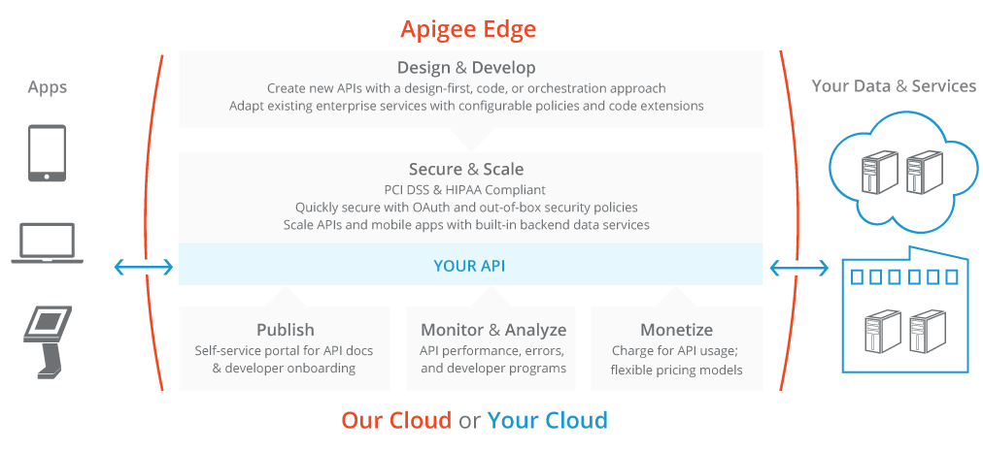
Apigee Edge: API Management

Slide 11



Apigee Edge: API Management
Analytics Services
Analytics Services
Business User
Monitor, manage, and measure success
Developer Analytics
Ops & Business Metrics
App Performance
Custom Reports
Developer Services
Developer Services
Developer Portal
Smart Docs
API BaaS
Increase adoption and value of APIs
Monetization
API Team
Developer
API Services
API Services
API Gateway
Policies & Programmability
OAuth &
Security
Versioning & Governance
Build, manage, scale, and secure APIs and Apps
Apps
Self-Service
State @ Scale
Flexible Deployment
Notes:
Main Points:
Introduce full marketecture
Script:
Apigee Edge enables digital business acceleration with a unified and complete platform, purpose-built for the digital economy. Edge simplifies managing the entire digital value chain with API Services, Developer Services, and Analytics Services.
API Services unites the best of Internet and enterprise technologies with API Gatway, Policies and Programmability, Versioning and Governance, and Oauth & Security.
Developer Services enable a great developer and community experience that accelerates API adoption, simplifies learning, and increases the business value of APIs.
Edge Analytics Services enable end-to-end visibility across the digital value chain with developer analytics, operational and business metrics, App performance, and custom reports that are necessary to monitor, measure, and manage success.
Edge is built on key architectural principles that are key to digital success – maintaining state at Internet scale, self-service throughout the product footprint to improve productivity, and flexible deployment – private or public cloud or hybrid.

Slide 12
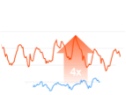
Apigee Edge: API-first - Built for APIs, Built with APIs
Authentication
and authorization
19 Data centers
7 Geographical locations
Alerting
Monitoring
Mission Critical Scaling
Developer Portals
Management UI
SDKs
Apigee Edge APIs
Gateway API
BaaS API
Analytics API
Gateway API
BaaS API
Analytics API
Policies
BaaS Engine
Analytics Engine
Proxies
Collections
Trends
Node.js
Graphs
API Usage
Connectors
Notifications
Customization
App Users
Highly Available “NoSQL” Data
Scalable Time-Series Data
Billing API
Monetization Engine
Notes:
Main Point
Apigee Edge is API-first itself – built with APIs and built to manage APIs.
Script
As leaders in the API space, we have taken an API-first approach to Apigee Edge. Everything we put out as a product has an API. All of the components of the product are exposed as APIs.
That’s what enables us to provide developers with a self-serve platform and the flexibility to configure or code on our platform; that’s what enables our customers to customize the developer portal they offer to on-board their developers; and that’s what enables both out-of-the-box analytics reports as well as customizable reports for operational and business monitoring.

Slide 13
Complete and unified across the entire API lifecycle
Design
Monetize
Develop
Analyze
Secure
Monitor
Publish
Scale
13
Notes:
Main Point
Apigee Edge addresses your needs across the entire API lifecycle
Script
Apigee Edge addresses your needs across the entire API lifecycle – from designing APIs to building them to scaling your API program and finally monetizing your APIs. Let me show you how Apigee Edge supports you throughout the API lifecycle. Apigee Edge offers a very broad product footprint – we won’t have time to cover all the needs, however, we’ll cover a few salient ones.

Slide 14
Complete and unified across the entire API lifecycle
Design Design first. Document Smart. Full support for Swagger 2.0
Monetize
Flexible rate plans
Internationalization support
Usage tracking
Limits and notifications
Develop
Configuration: Over 30 ready-to-use & configurable policies
Code: Built-in support for Node, JavaScript and Java extensibility
BaaS
Analyze
Complete visibility– from app end to backend
Automatically and continuously collect all API-traffic data out of the box
Secure
End-to-end security
Threat protection
Access control
Simple OAuth implementation for your APIs
PCI and HIPAA compliance
Monitor Centralized control, decentralized development
Multi-tenant architecture
Billions of API calls, including large spikes
Publish
Turnkey developer portal
Scale
Self-service
State @ scale
Flexible deployment
Notes:
Main Point
Apigee Edge addresses your needs across the entire API lifecycle
Script
Apigee Edge addresses your needs across the entire API lifecycle – from designing APIs to building them to scaling your API program and finally monetizing your APIs. Apigee Edge satisfies a number of your needs that would otherwise be very time consuming and costly to build and operate at scale.
Let me show you how Apigee Edge supports you throughout the API lifecycle. Apigee Edge offers a very broad product footprint – we won’t have time to cover all the needs, however, we’ll cover a few salient ones.

Slide 15
Apigee Edge
Design

Slide 16

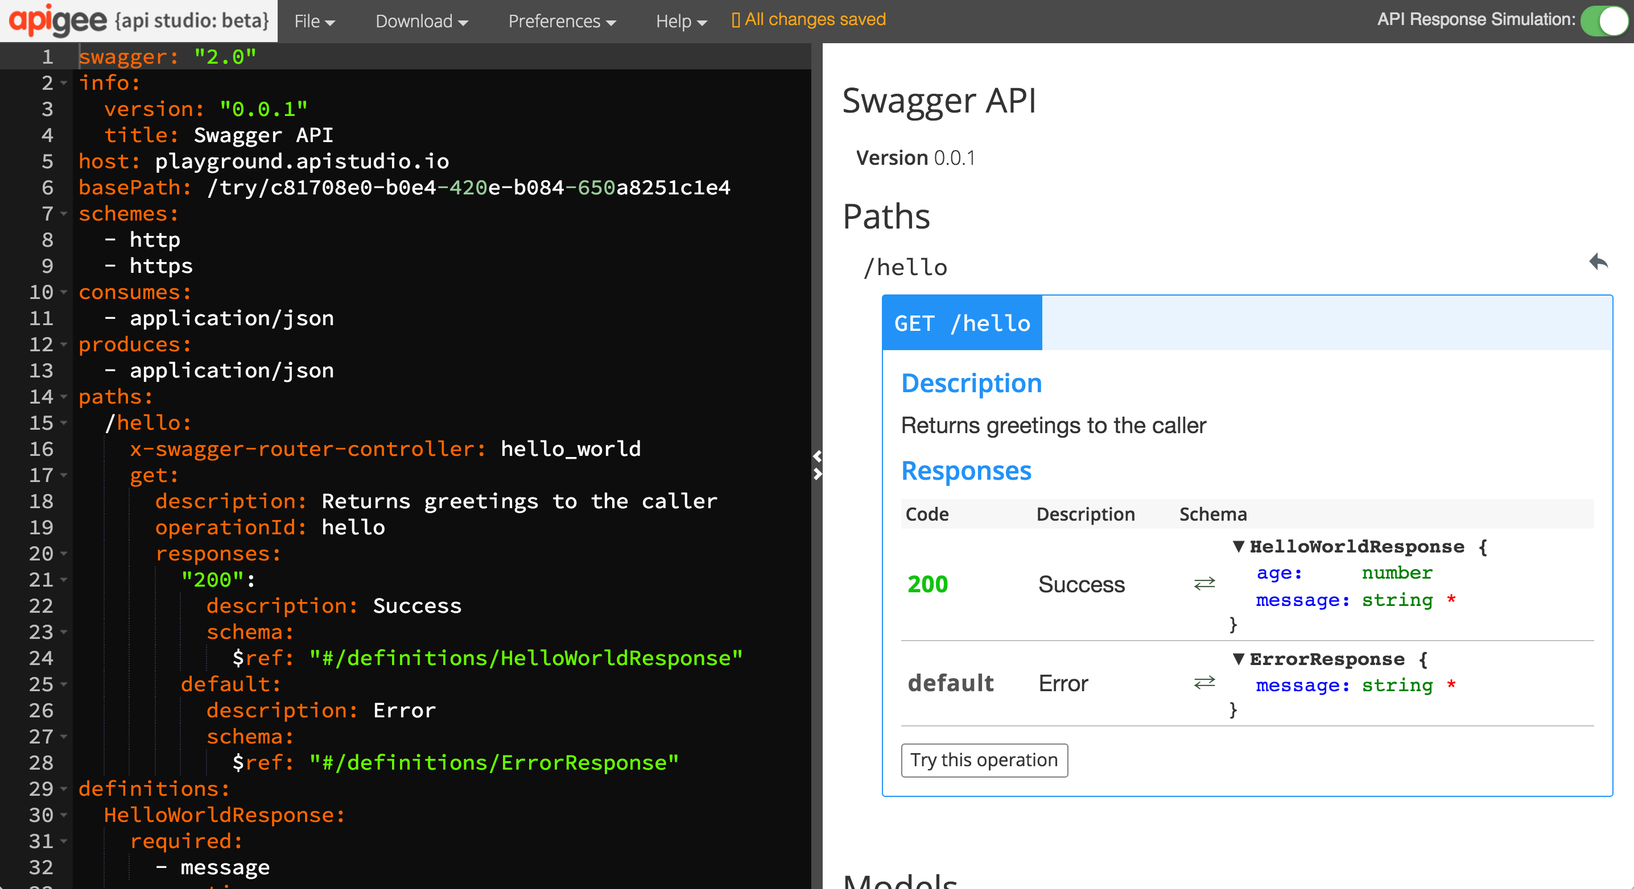
Build more consumable APIs
Design first. Document Smart. Full support for Swagger 2.0
Notes:
Main Point
Apigee Edge enables you to build more consumable APIs with a design-first approach
Script (needs to be verified)
APIs are built for app developers to consume. Its imperative that your APIs are useful to them – built in a way that makes their apps shine. If you build your APIs in a vacuum, you risk delivering APIs that don’t meet their requirements, which can result in costly and frustrating rework, and lengthy, unnecessary delays in getting your apps to market. Instead, Apigee Edge enables you to take a top down approach. You can design the APIs using Swagger and collaborate with your app developers to agree on a shape that works. You can use Smart Docs to build documentation for this API design. With this agreement in place, you can build the API knowing that they will be used. And While you’re building the API, your app developers can use mocks of the API designed and the smart docs to build their apps. With this agile approach, you increase your chances of delivering APIs and apps that make an impact, perform as expected; and deliver them FAST.
Link to Wiki
No differentiator page on Wiki
For Instance
None

Slide 17
Apigee Edge
Develop

Slide 18
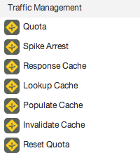
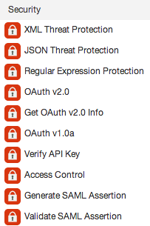
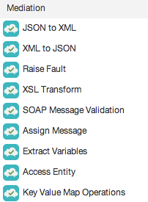
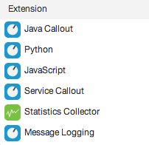
Build APIs faster
Manage interactions with API consumers and optimize performance
Secure APIs and protect back-end systems from attack
Transform, translate and reformat data for easy consumption
Extend with programming when you need it
Config - Over 30 ready-to-use and configurable policies Code - Built-in support for Node, JavaScript and Java extensibility
Notes:
Main Point
Apigee Edge includes over 30 easy to configurable policies and built in support for Node, JavaScript and Java extensibility
Script
Apigee Edge includes over 30 easy to configurable policies AND built in support for Node, JavaScript and Java extensibility
APIs developed with Edge can leverage the out-of-the-box, configurable policies, custom code written in JavaScript (Node.js) or Java, or both. The flexibility to leverage standard implementations, configuration AND code improves developer productivity by accelerating the time to solve both common and complex problems.
Common themes and use cases, are best handled with standard implementations and configuration. Apigee Edge provides Traffic Management, Security, Mediation and other policies out of the box that you can leverage, configure, and reuse across projects. These policies provide common, consistent, scalable, tuned implementations of common functionality.
Complex problems are best handled via software development, or a combination of configuration and development. Apigee Edge enables you to solve these complex or unique needs through extension polices. You can write these extension policies in JavaScript, Java, node.js, or external services.
In addition, with our micro-services architecture, you can implement a set small, independent, decoupled, focused processes with node.js and deploy them in the gateway to meet your unique needs.
Whether your needs are simple or complex, Apigee Edge provides you the flexibility you need to build APIs faster.
Link to Wiki
https://apigeesc.atlassian.net/wiki/display/SEP/API+Development+with+Configuration+and+Code
For Instance
None

Slide 19
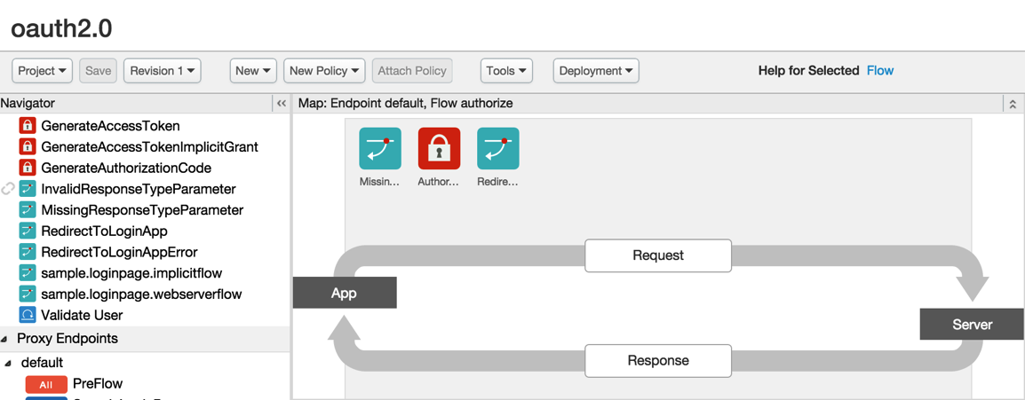
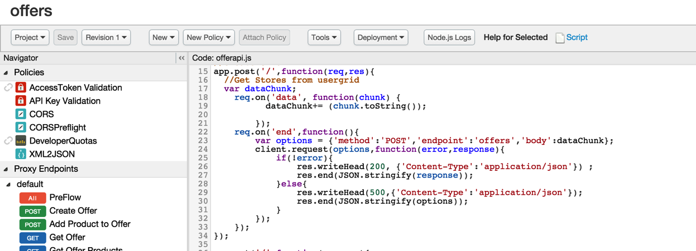
Increase reuse, consistency, and agility
Configuration Driven Proxy Definition
Effort
Configuration
Code
Code Driven Proxy Definition
Complexity
Connections, Resources, Security, Quotas, Policies (30+ OOTB)
Code and Configuration
Notes:
Main Point
Apigee Edge enables you to improve the productivity of your developers by empowering them to use as little or as much code as needed.
Script
You need to improve developer productivity, empower them to build APIs quickly and extend them to do anything advanced. We make it easy for developers to create proxies by writing zero code… or little code if they chose too.Developers can quickly get started by using over 30 out of the box policies and the self-service UI to create their proxies. They can then extend those proxies with light-weight code. This presents a healthy balance between getting started quickly and supporting complex requirements.
In addition, our design-first approach leveraging open-source swagger is unique. Developers can collaborate with their peers and app developers before writing code. In addition, using Apigee 127, they can code on laptops/on-prem and deploy it on-prem or cloud. We also support multiple languages which provides more flexibility.
Link to Wiki
https://apigeesc.atlassian.net/wiki/display/SEP/API+Development+with+Configuration+and+Code
For Instance
“You [Apigee] enable us to innovate at such speed we’ve turned from an aircraft carrier to 10,000 speed boats.”, John Donovan, Sr. EVP, Technology and Network Ops, AT&T (see separate slide)

Slide 20

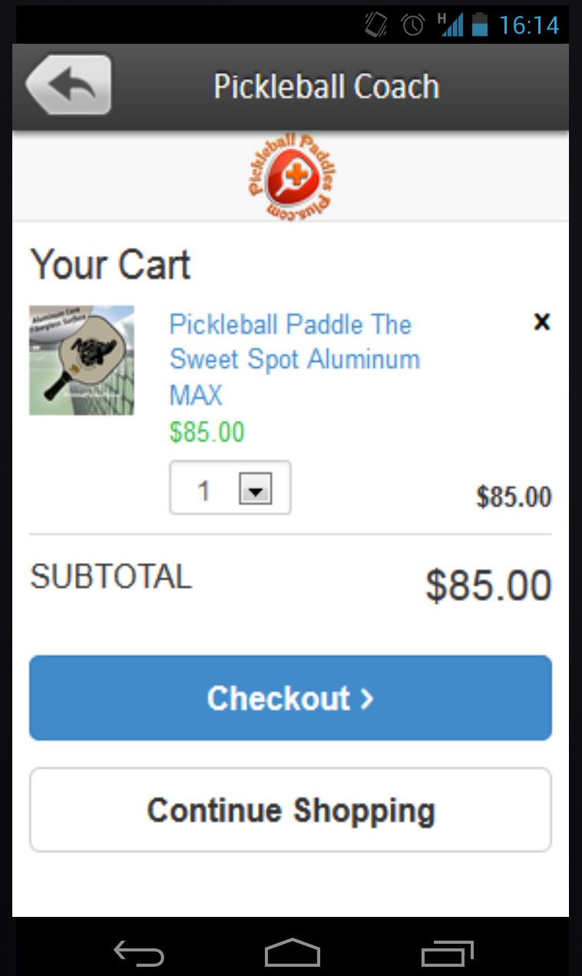


Build apps faster
Partner Services
User Data
Connections
Pre-built
Location queries
API BaaS
Existing backend
Configuration Management
Push Notifications
Datastore
Built in back-end as a service to store data for your apps and provide out of box social login, push-notifications, activity streams and more
Notes:
Main Point
Apigee BaaS enables you to deliver modern experiences faster
Script
Apigee Edge, includes API BaaS, a highly, optimized, scalable RESTful data store. With built in back-end as a service to store data for your apps and out of the box capabilities such as social login, push-notifications, activity streams, you can build modern experiences faster. API BaaS enables you to de-normalize data from systems of record so you can build systems of engagement. In effect, API BaaS enables you to develop like a startup, but scale like an enterprise.
It does so with a variety of capabilities.
Apigee BaaS eliminates the IT admin costs needed to provision new databases and app servers for each new app. It reduces custom app development spend on building features that drive app engagement such as social login, push notifications, location queries, and more. And it improves app performance and scalability cost-effectively.
When creating new apps (such as mobile apps) that need to scale, your existing data services may not have the data in a way that easily queryable (compared to key-value pair stores like memcache), scalable, or consumable by the app. Often the data is in a database or a data-warehouses that are not meant to be queried the way the app wants to. API BaaS provides a data service via APIs that allows for storing & querying the data the way you want without the expensive provisioning of new Cassandra / Elastic search and API tier.
All new apps prefer to integrate via APIs instead of direct DB connections. Instead of having to stand up a database, then stand up an API, API BaaS does this all in one go without the need to involve IT for additional provisioning.
New apps often call for storing transient data or application specific data. These apps are often too small to warrant standing up of its own database and API tier. API BaaS lets you quickly provision collections with no administrator involved.
New Apps often have “social” components or “graph” components it it (e.g. like buttons). Instead of building these components from scratch, API BaaS’ graph capabilities lets developers relate any 2 entities to form an easily queryable graph. This improves the time it takes to create new feature in an app dramatically.
Push notifications and location queries are proven features to drive engagement of apps. These features can take several months to stand up from scratch, and even more months to integrate together with data. API BaaS offers both features in an elegant way.
Most apps (especially retail apps) need geolocation services to drive engagement (e.g. Store locator. Building geolocation off traditional RDBMSs is not possible because out of box the indexing capabilities do not exist. API BaaS lets you quickly stand up a geolocation service.
App builders are always experimenting with new features for their mobile apps. Pushing these changes traditionally require releases to the appstore which is a slow process and relies on the end user to update their apps. API BaaS allows IT to push out new configuration to enable/disable mobile features so that they can experiment and tweak in production – all without requiring a new version to be uploaded to the app store. This feature includes an SDK for synchronization and offline access for configuration data, A/B testing, and pushing to specific devices.
Link to Wiki
https://apigeesc.atlassian.net/wiki/display/SEP/FEATURE+%3A+API+BaaS
For Instance
Morrisons uses API BaaS to drive their Store locator. Without BaaS, Morrisons would have had to stand up their own C* instance, followed by setting up their own app server to implement this small use case - increasing costs as well as increasing app development time.
Burberry’s social media app (artofthetrench.burberry.com) was built entirely on API BaaS because it was the fastest and easiest way to build a socially engaging app. Otherwise, they would have had to stand up their own C* instance and App server for this project. artofthetrench is too small of a project that would have been worth all this infrastructure development.
Burberry is using BaaS to cache some of their store inventory data from SAP and Salesforce for their clientelling app. If they had not used API BaaS as the caching layer, it is likely that they would overload their systems of record or possibly have had terrible performance.
Vodafone is using API BaaS for Push notification to drive better engagement of the MyVodaphone App. API BaaS is the ONLY on prem push notification system out there.
Woolworths using API BaaS for Offers and Shopping Lists (powering the Apple Watch App)
Walgreens realized they were collecting too much data in production from their phones and was able to dynamically reduce the amount of data captured without having to do an additional code push.

Slide 21
Apigee Edge
Secure

Slide 22
Secure all points of engagement
Users
Apps
Developers
APIs
API Team
Back-end
OAuth2
MFA
Federated Login
IP Access Control
API key
OAuth2
Mutual TLS
Access Block
Revoke
SSO
RBAC
OAuth2
Quotas
Spike Arrest
Threat Protection
Intrusion Detection
Bot Detection
RBAC
AD / LDAP
Audit
Mutual TLS
IP Access Control
Southbound VPN
End-to-end security PCI and HIPAA compliance
Notes:
Main Point
Apigee secures all points of engagement from user interactions to back end systems
Script
Security breaches are becoming increasingly common leading to brand damage, IP exposure, and costly mitigation procedures. Consumer expectations on security and privacy of PII data have increased dramatically.
Apigee Edge provides easy to use security features for each step of the value chain. In addition, the out of the box security features embody best practices and guidelines required by PCI and HIPAA regulations. With many security capabilities - Oauth 2 to secure user and app interactions, many easy to configure and extend self-service policies and features to mitigate threats to your APIs. e.g. Rate limiting policy to protect any traffic spikes due to DoS attacks, role based access control, Mutual TLS and more – Apigee secures all points of engagement from user interactions to the back end.
Apigee Edge is (penetration) pen-tested by a 3rd party vendor. This means our private cloud customers can deploy it without further security testing required. We can provide a pen-testing report to your internal security and audit team – this not only accelerates the time to deployment but it can also save you $25-50K of pen testing cost.
Cloud customers can rely on Apigee’s expertise and experience in hosting thousands of customer APIs in our cloud and resolving any emerging security vulnerabilities. We respond to security patches in days and release it so you don’t have to worry about new security vulnerabilities.
Apigee brings years of infrastructure and service delivery partner strength such as strategic partnership with AWS. For example we have mitigated risks to customers due to security vulnerabilities such as - FREAK, HEARTBLEED, SHELLSHOCK, POODLE. All responded within 24 hours with least impact to our customer APIs and availability. We're part of AWS Advisory Council to influence their strategic direction and security features. We have a strong architecture and AWS partnership (people, process, tech) to address DDoS on Apigee cloud.
Link to Wiki
https://apigeesc.atlassian.net/wiki/display/SEP/THEME+%3A+Security (see each section under this theme)
For Instance
Apigee Edge software is trusted by hundreds of customers in Health care, Financial and Govt vertical to protect their APIs and meet their PCI, HIPAA and other compliance needs.
Retail customers including Target, Home Depot, Kohls - Financial customers like Vantiv, Firstdata, Amex; Healthcare customers like Humana, Cambia Health, HCSC and various Govt customers.
When Heartbleed, FREAK, was discovered, we were able to mitigate the vulnerability within 24 hours with no visible impact to our customer API traffic
When AWS had a hypervisor vulnerability that required 50% of Apigee servers to be rebooted automatically without notification, we were able to sustain the reboots with zero downtime.
SAP does security pen-testing on every Apigee release and we have always passed their stringent benchmark for OWASP Top 10 and SANS 25 application security standard.

Slide 23
Apigee Edge
Publish

Slide 24
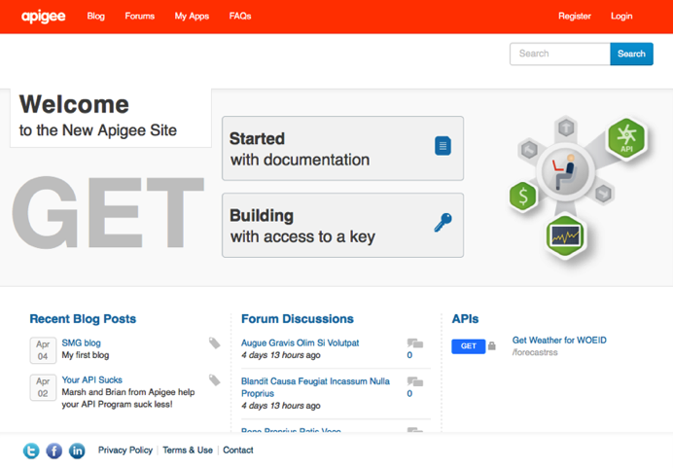
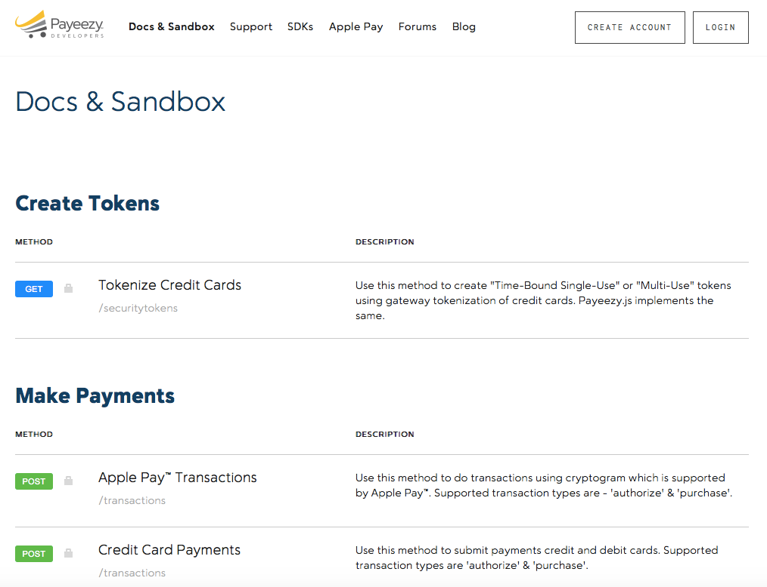
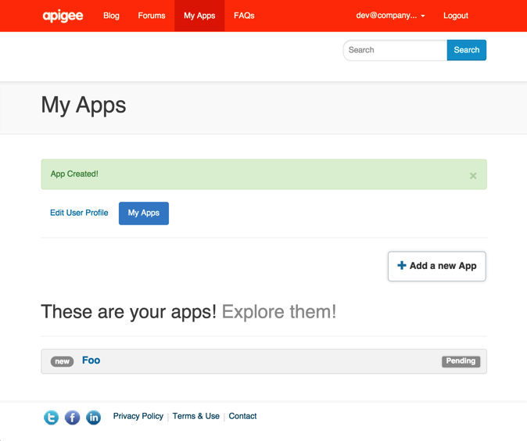
Make it easy for developers to use your APIs
“Reduced time to first app from
4 weeks to 6 hours.”
- Online Education Provider
Automatic or manual registration
Self-service app key requests
Self-documenting
Turnkey developer portal
Notes:
Main Point
Make it easy for developers to use your APIs with a secure and turnkey developer portal that gives them self-service access to your APIs, forums, blogs, sandbox, analytics, and more.
Script
Make it easy for developers to use your APIs with a secure and turnkey developer portal that gives them self-service access to your APIs, forums, blogs, sandbox, analytics, and more.
With Apigee Edge, you can deploy a custom and turnkey developer portal that provides self-service access to your APIs, api-keys, and SmartDocs. The developer portal comes with hundreds of pre-installed modules such as polls, blogs, and forums; external authorization for login, such as Google, GitHub, LDAP, and OpenId; Internationalization; Issue tracker integrations like BugHerd; Google Analytics; and more. In addition, with over 10,000 open source Drupal modules and themes available, covering a huge range of use cases, you can install and configure new add-ons to get the desired functionality, such as Jira integration, powerful workflow tools, content rating tools, and much, much more. Additionally, the developer portal is based on open source Drupal technology with a 1M+ developer community. This enables you to customize Drupal to meet your unique needs and easily find developers to augment your internal teams.
As developers participate in your API program, the analytics within Apigee Edge enable you to measure usage, adoption and engagement so you can tailor your APIs and program appropriately to meet their needs.
Leading enterprises such as First Data, Walgreens, Pearson, Equinix and many more are using the Developer Portal to make it easy for their developers to use their APIs.
Link to Wiki
https://apigeesc.atlassian.net/wiki/pages/viewpage.action?pageId=76415368
For Instance
Walgreens - launched their portal with minimal customizations on top of the out of the box portal. But on the other hand, ATT used Edge’s management APIs to build their own developer portal from scratch.
Equinix -https://developer.equinix.com/ - partner and internal . Onboard their users using an internal system and then the developers get access to dev portal via sso.
Gracenote - https://developer.gracenote.com and https://developer.ntt.com/en portals are available in both Japanese and English. They leverage the OOB i18n features.
Pearson - community.pdn.pearson.com a complete custom module built into http://developer.pearson.com/ . A nice custom built app gallery http://developer.pearson.com/product-showcase with capabilities like “Related Showcases” etc. done with Drupal’s powerful taxonomy feature. Custom feature like Bookmarks for contents.
First Data in their portal has different flows for customer on boarding and merchant on boarding. They have also built a custom flow for Certifying the apps which are getting registered in their dev portal.
Whatever flow you want to have for authentication :
EE - user is registered only by their support in their own support portal and then the details sent to the user
Gracenote - Enabled social login on their dev portal. Developers can choose to Login via facebook at the registration page.
First Data - included security questions as part of registration
Associated Press/Pitney Bowes wants to include their internal customer IDs generated from different systems while customer registers. Registration flow customized to make a call to their internal systems to generate/retrieve customer IDs to include in custom attributes of developer.
Vantiv - App certification process : Vantiv uses a App certification process to qualify and graduate developers from a sandbox environment to production. Today, it is a manual and high touch process. Vantiv wanted to move to a more self service model and therefore automate the app certification process. The new model is that the developers takes tests which are logged, and when they pass the test, they automatically are approved to move their apps to production. The extensibility of our developer portal in addition to the inbuilt rules engine allowed us to build this custom workflow out resulting in a highly self service workflows that the customer finds extremely helpful.

Slide 25
Apigee Edge
Scale

Slide 26
Operational Excellence
Region
Region
Pod
Pod
Pod
Pod
Traffic Isolation Independent Scaling
API Processing
Data
Low Latency
Management
UI, API Definitions, Users, Roles, System Configurations
Simpler Administration
Centralized control, decentralized development
Multi-tenant architecture
Notes:
Main Point
Apigee Edge’s multi-tenant architecture enables you to exercise centralized control while supporting decentralized development across multiple teams.
Script
As your digital business evolves, you will need to define, refine, and deploy APIs. Managing the API software development lifecycle across a geographically distributed teams while operating at Internet scale presents challenges. Apigee has optimized the API SDLC by providing a set of APIs and a UI based on these APIs that greatly simplifies defining, refining, and deploying APIs. There are a few key challenges to address:
Cloud scale deployment
Deploying code to multiple servers in a geographically distributed system is challenging, and requires planning, process, and tools. Edge simplifies deployment through an API first philosophy and centralized management – effectively a single point of contact – and through its distributed architecture. When deploying an API into an environment, Edge automatically pushes those new and/or updated APIs to the API runtime server.
Zero downtime deployment
Maintaining dial-tone continuity while upgrading proxies doesn’t happen without a deep understanding of global, cloud-scale deployment and the consequences of dropped transactions. Edge is designed to gracefully transition to newer versions of existing APIs without disrupting in-flight traffic. This ensures that inbound traffic is not rejected during deployment of a new revision. Edge will gradually transition to the new revision; in-flight APIs will continue to use the previous revision. API calls received after the new revision has been deployed will be routed to the new revision. Once the in-flight queue has been emptied, the previous revision will be disabled.
Independent Scaling
In the web world, you are likely to face significant spikes in API traffic – both planned and unplanned. You need the ability to handle these order of magnitude spikes without requiring complex and time-consuming procedures. Apigee Edge is designed to linearly scale at all layers of the software. Furthermore, Apigee Edge enables you to temporarily add additional capacity to support known traffic patterns (e.g. Black Friday shopping, sports season, etc.), which can then be dissolved when the need no longer exists.
Multiple revision management
With Edge, API developers can maintain multiple environments within the same infrastructure. This greatly simplifies enhancing APIs in a safe, secure manner. Furthermore, switching between revisions in an environment is trivial and can be accomplished via an API call or the management UI.
Updates
The API tier is one of the most critical link in the entire value chain between the users’ apps and your business. Therefore, all updates made to either add new capabilities, or to fix vulnerabilities within the Apigee Edge platform are applied in an orchestrated manner without bringing down the service for any customers
Multi-Region Deployment
Among other factors, great in-app user experience depends heavily on fast response times, and the best way to achieve that is to minimize the path between the client apps and the APIs. By enabling a multi-region deployment of the Edge platform across multiple geographies, you benefit from lower latencies for your API traffic because API requests are automatically routed to the closest data center from the origin of those requests.
Isolation & Efficiency
The deployment architecture is designed to ensure process and data isolation of the API runtime traffic for each customer such that it is not affected by API traffic from other customers deployed in the Apigee cloud. At the same time, each of the software component that makes up the Edge platform is deployed and managed within administrative groups to ensure maximum resource utilization and automated monitoring and management.
Distributed Teams
Your central IT team can exercise data privacy or other controls centrally, while enabling different teams to follow their own software development lifecycle to build their APIs. Your central IT team continues to maintain complete visibility into complete API footprint across your company. Additionally, In a fast changing digital world, this capability makes it very easy to bring on a new team – the incremental costs are minimal and teams can fail fast or succeed fast when building new APIs.
Individually these challenges are difficult to overcome, and would require complex, expensive, and/or customized solutions. Apigee recognizes these features as vital to the success of deployment and operation of an API program and has addressed these challenges directly in the product.
Link to Wiki
https://apigeesc.atlassian.net/wiki/display/SEP/Centralized+Management%2C+Global+Deployment
https://apigeesc.atlassian.net/wiki/display/SEP/Centralized+Control+with+Decentralized+Development
For Instance
Equinix – http://www.lightreading.com/data-center/cloud-strategies/equinix-unifies-the-cloud-with-apigee-apis/d/d-id/712908 - With Apigee Edge, Equinix customers can connect to APIs deployed in any of the 17 cloud service providers Equinix hosts.
SAP - http://scn.sap.com/community/labs/blog/2014/11/04/api-economy-and-mash-up-programming - SAP has chosen Apigee Edge as the API management platform on which to host APIs that expose existing SAP HANA functionality. Of the many benefits provided by Apigee Edge, the ability to operate a cloud scale API program with centralized management and global deployment was a clear benefit.
Target - http://apigee.com/about/resources/innovator-spotlights/target-meeting-new-customer-expectations-apis - Target has created a resilient, scalable API program to help realize a seamless, multi-channel experience. Developers use these APIs to build innovative, customer-facing mobile apps.

Slide 27
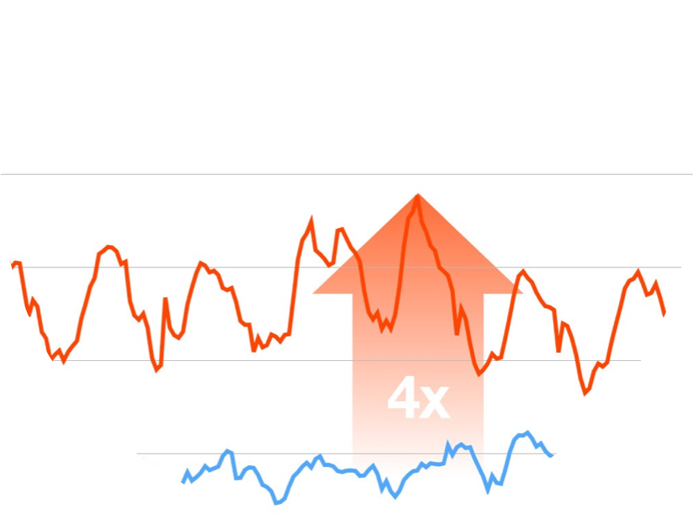
Support web-scale mission-critical operations
4x scale year/year
Scaled capacity by 2x within 2 hours for one customer
Zero impact to all other customers
Apigee Cloud Stats 2014
API requests handled: 102B+
Servers managed: 3000+
Apigee Black Friday Holiday Traffic
Billions of API calls, including large spikes, processed regularly without disruption
Notes:
Main Point
Apigee Cloud proof point for State @ Scale
Script
What if you needed to scale to meet 2x load with 4 hours notice? What if you needed to patch and reboot 60% of your infrastructure (1000+ instances) with 48 hours notice and zero downtime? What if 10 of your most critical customers collectively had 3x more traffic over a 5 day period (1 Billion transactions) and you could not afford one P1? All 3 of these things have happened to Apigee in the last 12 months and we passed with flying colors. Apigee cloud was able to seamlessly scale and handle the spikes and higher volumes without impacting any customers.
We were able to scale so well because the the Apigee cloud is built to provide customers with a globally distributed platform that is continuously available for deploying their APIs. Apigee ensures that the cloud platform scales to handle any volume of traffic while maintaining high performance, and that all software updates are applied with zero downtime.
Over the past 18 months, we have seen a 10x explosion in API traffic, and we now process over 3B transactions/week in the Apigee Cloud. When we talk to customers, we find that API teams are becoming very decentralized such that our customers no longer even know when a new Mobile App may be launched or an event will drive 10x traffic to their API’s. Our Operational Excellence enables us to serve you by focusing on dialtone at scale, speed of execution, and openness & transparency as it relates to our cloud infrastructure.
For Instance
Apigee cloud runs on 3000+ servers deployed across 19 data centers that are distributed over 7 geographic regions
The entire Apigee cloud is managed and administered by only 6 engineers
15+ billions API transactions go through Apigee cloud every month
For Black Friday in 2014, Apigee scaled up the infrastructure capacity for one of the retailers by 2x within 2 hours
Apigee rolls out software updates every 2 weeks for all customers while maintaining 99.99% availability
About 20-40 auto-heal actions are applied per day (approximately 1% of the total infrastructure) to proactively and gracefully restart software instances (typically within 2-5 minutes) that are determined to be under undue memory pressure or number of close-waits, which results in averting catastrophic failures of those instances that could actually cause service disruptions for customers
During Black Friday in 2014, Apigee was opening P1 tickets with our customers alerting them to problems with their own backend systems that were affecting the quality of service of their APIs
In Sept. 2014, Amazon notified us that we had to reboot over 65% of our infrastructure due to a Hypervisor security vulnerability they had discovered, AND within only 48 hours. – Due to the redundancy and failover capabilities in the Edge architecture, we did not experience any P1 outages as a result of this event. (https://blog.apigee.com/detail/apigee_and_the_aws_maintenance_reboot_all_clear ).
A leading provider of vehicle and driver safety and security services saw 10x increase in traffic in 3 months due to additional service providers coming online with their roadside service - Apigee was able to meet their scaling requirements quickly.
Leading Retailer – Saw 20M incremental transactions (including commerce) added in 1 week due to launch of Tablet and Android Apps.
Large Public Service Broadcaster – Sees frequent 40x increase in traffic from their digital properties (web, tablet, phone) within minutes, due to specific references or call to action on Broadcast television. Apigee is able to handle the increase in traffic without issues because of the dialtone quality of our Cloud operations.
Key Points to Reiterate
Reiterate specific data points to highlight how the apigee platform is built to handle significant spikes in planned and unplanned traffic without incurring any downtime.
For example reiterate these 3 things have happened to Apigee in the last 12 months and we passed with flying colors: meet 2x load with 4 hours notice? patch and reboot 60% of your infrastructure (1000+ instances) with 48 hours notice and zero downtime, 10 of our most critical customers collectively had 3x more traffic over a 5 day period (1 Billion transactions) and we could not afford one P1?
For example: Over the past 18 months, we have seen a 10x explosion in API traffic, and we now process over 3B transactions/week in the Apigee Cloud.
We were able to scale so well because the the Apigee cloud is built to provide customers with a globally distributed platform that is continuously available for deploying their APIs. Apigee ensures that the cloud platform scales to handle any volume of traffic while maintaining high performance, and that all software updates are applied with zero downtime.

Slide 28

Largest API cloud platform and private cloud provider
19
7
availability zones
regions
Apigee Cloud
Private Cloud leading Telco
1⁺ Billion calls / week
1B+
99.999%
transactions/day
Multi-Datacenter Deployment
API availability
60%
50k
4x
top 10 global retailers
Peak requests per sec
scale year/year
Private Cloud = Public Cloud
Notes:
Main Point
Apigee Edge is the largest API Cloud provider, providing the highly scalable and secure environment to run your APIs
Script
Apigee Edge is available both as a SaaS option and also to be hosted on your private cloud. You get all the benefits from Apigee Edge whether you run it in our public cloud or if you choose to run it on your private cloud.
The Apigee Cloud is the largest API Cloud in the industry with over 1 billion API calls per day running through across 7 regions, 19 availability zones, at 99.998% availability.
The experience we have gained over the years with some of the most demanding customers has enabled us the provided the industry’s most robust, scalable platform.
When Black Friday comes and 6 of top 10 retailers are on our platform, we handle the 2x spike in volume over a short period of time without a glitch. Our customers like Target & Kohls trust us to deliver and we do
For Instance
Apigee Edge hosted by Apigee is operated for unprecedented scale and performance. Some data points :
7 Regions, 19 Availability zones
3000+ servers
~1 Billion transactions / day
>99.99% API availability
~20 ms average latency

Slide 29
Apigee Edge
Analyze
Monitor

Slide 30
Gain visibility into the entire digital value chain
Relevant, Actionable and Extensible Dashboards, Tools & Custom Reports
User
App Analytics
Developer Analytics
API Analytics
Backend
App Performance
App Usage
API Performance
Filter by app version, device, platform, OS, etc.
Top Developers
Developer Engagement
Top API Users
Top Products
Top Apps
API Traffic Patterns
API Performance
Geo location
Anomalies
Multiple metrics – traffic, response times, errors, data exchange, etc.
Complete visibility– from app end to backend
Automatically and continuously collect all data about your API traffic out of the box
Notes:
Main Point
Apigee Edge provides complete visibility into the entire digital value chain – from app end to the back end
Script
The digital value chain stretches all the way from the user to the back end services. Digital requires you to know how you’re doing at every stage of the value chain. Apigee Edge provides complete visibility into the entire digital value chain – from the app end to the back end.
Apigee Edge automatically and continuously collects analytics data from all API traffic. As a result, you do not need separate tools for API analytics, saving you costs in terms of resources, infrastructure and on-going maintenance. Since the data collection is continuous, you can see meaningful API trends and API failures that may not be apparent when analytics are measured at coarse aggregation intervals. In fact, Apigee Support uses the same analytics data to help resolve customer issues.
Apigee Edge provides complete visibility into the health and performance of your APIs. Apigee Edge provides a number of out of the box charts that help you measure and monitor traffic, performance, latency, errors and more. The out of the box charts also reduce downtime – you can quickly identify potential bottlenecks with target endpoints based on the observed API performance and usage trends. Using this information, you can make changes to their target endpoints and avoid potential downtime.
Apigee Edge enables you to improve the productivity of your developers consuming your APIs by using the OOTB charts to identify issues related to latencies or errors, and proactively reaching out to those developers to help them properly consume APIs. This results in consuming developers fixing their apps quickly with the help of the API team rather than doing it on their own.
Apigee Edge provides complete flexibility with self-service custom reports. You can quickly adapt to changing business and customer needs by extending the core analytics to capture additional data from your APIs and create powerful custom analytics reports using the self-service interface. Edge Analytics allows you to create custom metrics and dimensions and use them in any report, custom report or analytics API. You can use virtually any attribute that describes traffic to create custom metrics and dimensions. This means you can use more than 500 variables available in the gateway, or extract them from the API request, response, request payload or response payload. You can use these custom variables in default reports such as Investigate Anomalies or in Custom Reports
While Apigee Edge collects a lot of API data, we recognize that you often also have a need to combine this data with other operational and business data obtained by other means. Apigee Edge enables you to create custom queries against raw traffic data using RESTful APIs. You have full flexibility to obtain Apigee collected metrics using automated scripts as-and-when needed. Without this capability, you would need to understand the underlying data schema, use database specific SQL scripts, etc. to obtain the raw traffic data that you need. As a result of these Analytics Apis, you can reduce data extraction costs and easily integrate with existing reporting, analytics, and visualization tools. This reduces the time, effort, and costs of making Apigee Edge to work with existing enterprise tools and initiatives.
In addition, Apigee Edge provides analytics for your mobile developers enabling them to monitor the usage, performance, and crashes and errors in their mobile apps.
This end to end approach provides unprecedented information about how your entire value chain is interacting with your services.
Link to Wiki
https://apigeesc.atlassian.net/wiki/display/SEP/Out-of-the-Box+Charts+for+API+Performance+and+Usage
https://apigeesc.atlassian.net/wiki/display/SEP/Automatic+Continuous+Data+Collection+from+all+API+Traffic
https://apigeesc.atlassian.net/wiki/pages/viewpage.action?pageId=76415356
https://apigeesc.atlassian.net/wiki/display/SEP/Apigee+APIs+to+Create+Custom+Queries+Against+Raw+Traffic+Data
For Instance
A customer had a 7 minute outage and didn't even know about that outage from the analytics reports because the data they collected was done done at a coarser granularity and aggregated. Using Apigee Edge, we would have known about the outage based on the continuous analytics that are collected, which would have shown up in the out-of-the-box dashboards. The customer may be having multiple outages like this without their knowledge, which may result in customer satisfaction going down and may even impact revenue.
Another data point is Apigee’s own usage of these API analytics in supporting our Cloud customers. Using this capability, Apigee was able to collect metrics on over 100B+ API calls that happened in 2014 - the Apigee Support team did not have to do anything to collect these metrics, but found this analytics data to be very valuable in resolving customer issues.
Large retailer encountered a situation where users of their mobile app had to re-login frequently. This was a result of an inadvertent change to the TTL of the refresh token from 60 days to 2 hours. Using the Analytics APIs, the customer and Apigee GSC were able to run queries that helped them get Refresh Token TTL information given respective Access Token IDs and identify this misconfiguration.
First Data uses Analytics APIs to measure the total revenues driven by each retailer partner that's using their Payeezy APIs for Apple Pay. Immediately following the launch of Apple Pay, First Data was able to measure the success of the Apple Pay program across various retailers by capturing the transaction amounts from the API message payload and generating analytics reports in Apigee without any custom development.
After launching their APIs for developers, Sony Mobile wanted to measure the success of their API program by tracking daily growth in adoption of their APIs by developers and apps. They used the Analytics APIs to run their queries from a Node.js application that collects traffic data for each API, developer, and app from the launch of those APIs to measure the overall growth and individually by each developer and app. This data is compiled and reported up to their executives on a daily basis.

Slide 31
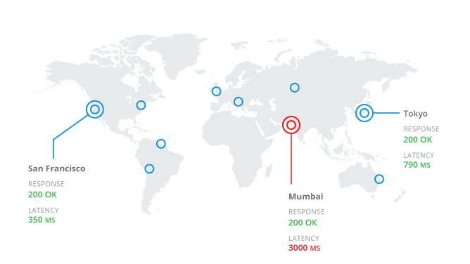
Monitor the health of your APIs
Measure, validate and compare latency across regions
Notes:
Main Point
API Health is a cloud based service that enables Apigee Edge customers to perform a quick health check on APIs
Script
API Health is a cloud-based service that delivers a standard set of key information on any API - including third party APIs - so that development and operations teams can know if the APIs they depend upon for their mobile and web apps are working. Use API Health to collect a standard set of vitals on APIs to answer two very important questions: Are my APIs alive? How are they behaving? API Health employs a network of probes deployed across globally distributed data centers in the cloud to continually measures the success rate and performance of APIs, and alerts DevOps teams to any failures or slowdowns of their APIs.
Link to Wiki
For Instance

Slide 32
Apigee Edge
Monetize

Slide 33

Monetize APIs: Any partner, any business model
Revenue-sharing models (API provider charges developer)
Fee-based models (API provider charges developer)
Freemium models
Fixed
Transaction
Duration
Flexible
Transaction Volume
Quantity
Hybrid (flat fee plus fixed and flexible)
Custom Attribute
Hybrid
Revenue / Volume Bands
One-time
Subscription
Advance / Arrears
Pro-rated / Full amount
Flexible rate plans, internationalization support, usage tracking, limits and notifications
Notes:
Main Point
Apigee Monetization provides end-to-end self-service capabilities to create, publish, and access a variety of rate plans and other configurations.
Script
To build a digital business, you need a way to monetize your APIs. You need support for many different business models and you need to monetize without without going through expensive and disruptive changes to back systems to meet business needs.
Apigee Monetization provides end-to-end self-service capabilities to create, publish, and access a variety of rate plans and other configuration. API product managers / business users can independently package, price & publish API products & packages. There is little to no dependence on IT to roll out these API plans. For instance, A travel/hospitality service provide will be able to quickly create revenue share, freemium and many innovative pricing models to experiment on what works best for their partners. They don’t have to waste time & money on changing their financial systems to try out new pricing models.
Apigee provides a breath of out-of-the-box pricing models that you can use to create variety of rate plans. Finding the most effective API monetization model is often iterative. To support an agile approach, Apigee Monetization supports iterative experimentation, enabling you to succeed fast or fail fast without requiring the costly investments and extensive changes to existing systems that traditional approaches will require. For instance, A major European telecom provider is designing new business models and using Apigee’s monetization features to introduce a new messaging product (SKU) into their offerings. Typically, introducing a new product into a financial System of record for the provider takes 6-12 months. With Apigee's monetization capabilities, the provider will be able to implement their plans in a fraction of the time.
Apigee monetization supports multiple currencies, end-to-end billing and export usage reports to sync. with existing financial/accounting systems. With Apigee Monetization, you do not have to waste cycles on custom integrations to connect usage & billing across your disparate backend offices globally and sync currencies across disparate systems. For example, a leading business profile data provider (Dunn & Bradstreet) is using Monetization to track usage & billing for their partners. Our solution will simplify billing complexities due to multiple currencies and disparate backend financial systems.
Finally, Apigee Monetization enables you to proactively track usage and use limits, and notify your partners on their usage and plans. By notifying customers and partners before they accrue huge overages enables you to avoid unnecessary billing disputes and the resulting dissatisfaction and revenue loss. In addition, tracking partner usage patterns enables you to identify any upsell opportunities or suggest a better plan. For instance, a leading travel / hospitality service provider sets limits of use and manage notifications for expirations, renewals and overages
Link to Wiki
https://apigeesc.atlassian.net/wiki/display/SEP/FEATURE+%3A+Monetization (see features within this area)
For Instance
A travel/hospitality service provider will be able to service market opportunities with limited to no-touch from the enterprise sales team. Additionally, they will be able to provide an automated workflow for the purchase of plans, bills receipts and notifications.
A Telco/Service Provider mentioned that what would typically take a 6-12 month effort can be accomplished in fraction of the time with Apigee's monetization features. This speaks to the products capabilities to provide faster time-to-market and quickly capitalizing on market opportunities.
A travel/hospitality service provide will be able to quickly create revenue share, freemium and many innovative pricing models to experiment on what works best for their partners. They don’t have to waste time & money on changing their financial systems to try out new pricing models.
A major European telecom provider is designing new business models and using Apigee’s monetization features to introduce a new messaging product (SKU) into their offerings. Typically, introducing a new product into a financial System of record for the provider takes 6-12 months. With Apigee's monetization capabilities, the provider will be able to implement their plans in a fraction of the time.
Leading business profile data provider (Dunn & Bradstreet) is using Monetization to track usage & billing for their partners. Our solution will simplify billing complexities due to multiple currencies and disparate backend financial systems.
A leading travel / hospitality service provider sets limits of use and manage notifications for expirations, renewals and overages
Key Points to Reiterate
Monetization enables you to truly treat your APIs as products and build a business around them
Flexibility to support wide variety of business models, rate plans, multiple currencies, as well as end to end billing and enables you to export usage reports to sync with existing financial / accounting systems.
With Apigee Monetization, you don’t have to adapt your business to match the technology – we can support virtually any business model. And you do not have to waste cycles on custom integrations to connect usage & billing across your disparate backend offices globally and sync currencies across disparate systems
Enables you to “fail fast” or “succeed fast”

Slide 34
Complete and unified across the entire API lifecycle
Design Design first. Document Smart. Full support for Swagger 2.0
Monetize
Flexible rate plans
Internationalization support
Usage tracking
Limits and notifications
Develop
Configuration: Over 30 ready-to-use & configurable policies
Code: Built-in support for Node, JavaScript and
Java extensibility
BaaS
Analyze
Complete visibility– from app end to backend
Automatically and continuously collect all API-traffic data out of the box
Secure
End-to-end security
Threat protection
Access control
Simple OAuth implementation for your APIs
PCI and HIPAA compliance
Monitor Centralized control, decentralized development
Multi-tenant architecture
Billions of API calls, including large spikes
Publish
Turnkey developer portal
Scale
Self-service
State @ scale
Flexible deployment
Notes:
Main Point
Apigee Edge addresses your needs across the entire API lifecycle
Script
Apigee Edge addresses your needs across the entire API lifecycle – from designing APIs to building them to scaling your API program and finally monetizing your APIs. Apigee Edge satisfies a number of your needs that would otherwise be very time consuming and costly to build and operate at scale.
Let me show you how Apigee Edge supports you throughout the API lifecycle. Apigee Edge offers a very broad product footprint – we won’t have time to cover all the needs, however, we’ll cover a few salient ones.

Slide 35
Apigee Edge
Demo

Slide 36
Labs
Apigee Edge DevJam 2.0 labs…

